Slide 1
Team Names Are Hard ICT398 Milestone 2
Speaker: Dylan Blereau
Presented By Bryce Standley, Christopher Logan and Dylan Blereau

Slide 2
Milestone 2 Requirements
Speaker: Dylan Blereau
Implement our own Physics Collision Resolution/Response
Create three different types of NPC (AI) in terms of:
Emotion
Affordances
Incorporate both into our engine setup from Milestone 1
Add Special Features

Slide 3
Presentation Outline
Speaker: Dylan Blereau
- Project Tools
- Physics
- Emotions
- Affordances
- Special Features
- Milestone Demo
- Question Time

Slide 4
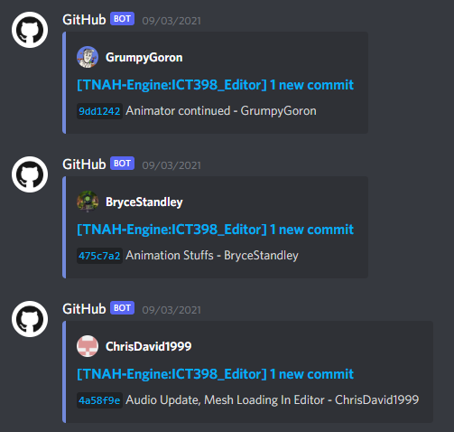




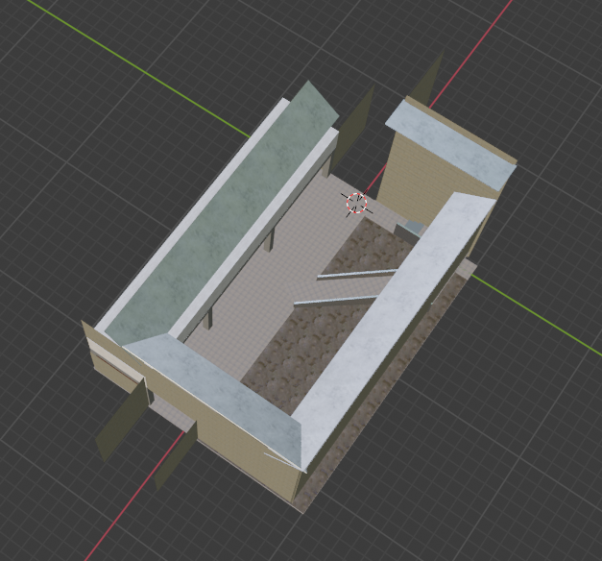


Project Tools
Speaker: Dylan Blereau
GitHub
Trello
Discord
Image 1 – GitHub Bot within discord
Blender
OneDrive
Visual Studio
Image 2 – Map Model in Blender
Notes:
Throughout the development of the project presented today in Milestone 2, we made use of various different tools
GitHub was used as our version control platform, largely due its relative ease of use alongside the fact it’s a platform we’ve all used before.
Trello was a tool Bryce suggested we use to track the progress of components of the project milestone. It's easy to use card system allows for cards to be moved into columns such as, in progress, needs bug fixing, complete etc
Discord was our communication tool of choice, allowing for us to contact one another throughout the day if we had any queries or needed assistance. Because it was the platform we were all on the most, we incorporated bots into the discord to alert each member when commits were live on github or that cards had been moved or completed in trello.
Blender was what we used for organising and adjusting our models, with the map in the milestone created in Blender.
OneDrive was used to allow for easy sharing of documentation, while Visual Studio was the IDE we used to develop the application. Shoutouts also to Rider for Unreal Engine, an IDE that Bryce and Chris used heavily.
I’ll now pass you on to Bryce who will discuss Physics.

Slide 5
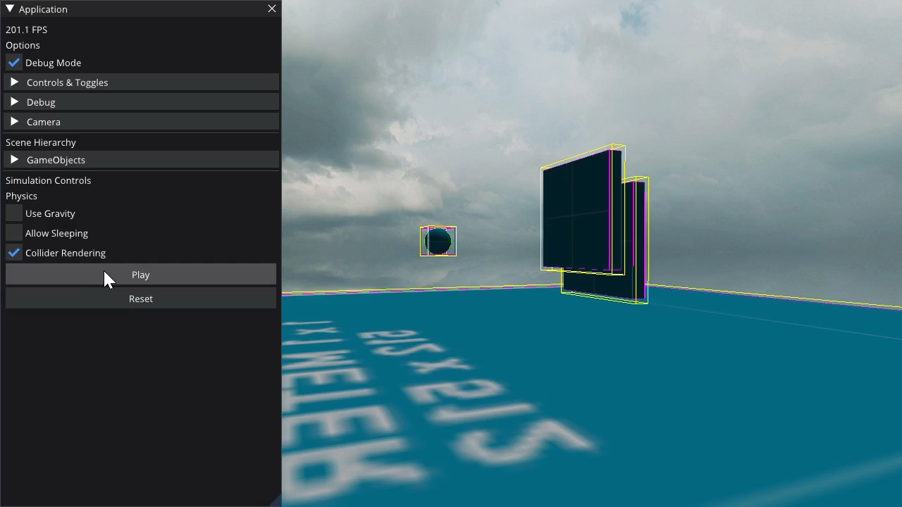
Physics
Speaker: Bryce Standley
Dynamic Collision Detection
Frictionless Collision Resolution / Response
Dynamic, Static and Kinematic Body Types
Box, Sphere and Capsule Collision Shapes
Notes:
Thanks Dylan ,
The physics system we developed uses Dynamic collision detection using react physics library – wrapped with our own collision detection data structure.
Frictionless collision response was implemented with provided physics formulars during the semester allowing the collision detection system to queue and process a frictionless impulse response to a collision on each colliding body.
Different rigidbody types have been implimented to determine what and how different the physics engine processes each collision being applied to the body. For instance, Kinematic bodies are able to be moved manually using its transform component and collision penetration correction prevents the body from moving through another body but no velocity or collision impulses are applied to the body.
Leveraging react physics for collision detection allows the use of multiple collision shapes including box, sphere and capsules. Using these shapes we calculate accurate physics properties for each shape using their respective formulars for properties like their local space inertia tensors. The local inertia tensors are then used to calculate a World inertia tensor of a rigidbody using the Parallel axis theorem to later process collision impulses.

Slide 6
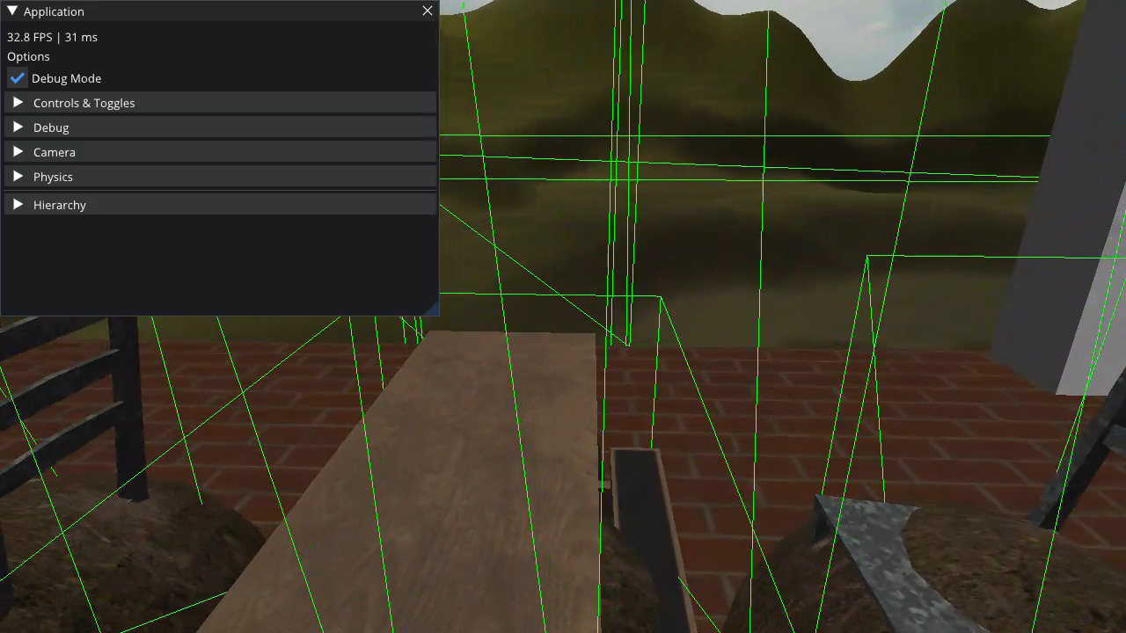
Physics
Speaker: Bryce Standley
if(rb1.Type != Static && rb1.IsAwake)
{
rb1.Position +=
contactNormal * (item.Penetration / 2) * -1)
}
…
linear_impulse = lambda * contactNormal
…
if(rb1.Type == Dynamic && rb1.IsAwake)
{
rb1.LinearVelocity += linear_impulse * rb1.InverseMass
rb1.AngularVelocity += lambda * rb1.WorldInverseInertiaTensor *
item.Body1ContactPoint.cross(contactNormal)
}
Notes:
Penetration correction is applied to all rigidbodies that aren’t static. This prevents Kinematic and Dynamic bodies from moving through eachother but also prevents from static bodies from being moved by collisions with other bodies.
Impulse response is applied to all dynamic bodies within the scene. This again further prevents impulses being applied to the incorrect body.
In the small demo on the side, you can see the player is a Kinematic body being moved manually and penetration correction is being applied, the table is a static body that cant be moved at ull by physics or collisions and finally the thrown object is a dynamic body using both penetration and impulse response applied to animate the movement of the object using the laws of physics.

Slide 7
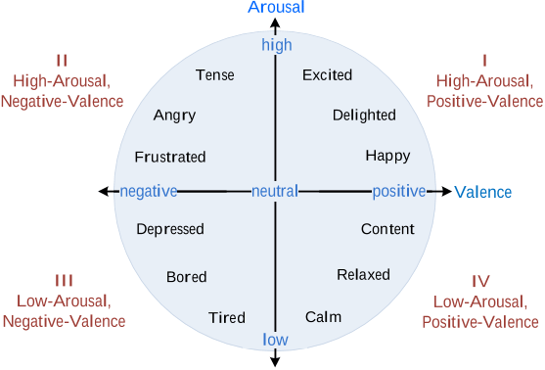
Emotions - The Circumplex Model
Speaker: Dylan Blereau
Arousal | Valence
Represents the Intensity of Emotion | Represents the Degree of Emotion
Range between 1 and -1 | Range between 1 and -1
Source: https://www.researchgate.net/profile/Zhe-Liu-55/publication/324664655/figure/fig1/AS:617659670470656@1524272949294/Core-emotions-established-in-the-circumplex-model.png
Notes:
When designing the emotion system, our research led us to the Circumplex Model.​
​
The model presents emotion in an easily understandable 2D plane. The x-axis represents Valence, which is the positive or negative degree of the emotion, while the y-axis measures the level of arousal, which refers to the level of intensity of the emotion. ​
​
What made this model ideal for us was the fact that it provides a visual representation of the range data, allowing us to more easily use number values to represent the current mood of an NPC. The neutral point of the model represents zero, with both axes ranging between 1 and –1. ​
Although the Circumplex Model allows a way to determine emotions, there were other aspects of behaviour we needed to handle, such as the mood of the NPC, as well as their character traits that form their personality.
Before I explain our approach, I just wanna give a quick refresher of what these behaviours all are.

Slide 8
Emotions, Moods, Traits, Personality – A Brief Refresher
Speaker: Dylan Blereau
Emotions – Change in behaviour over a short time and responsive to immediate events
Moods – Longer lasting behaviour, measured in hours or days
Traits – Long lasting aspects of behaviour that last years or even a lifetime
Personality – A collection of behavioural traits that last a lifetime
Notes:
Emotions are changes in behaviour over a short time in response to immediate events and are arguably the most important behaviour in our Virtual Environment as they are the behaviours you can easily manipulate.
Moods are longer lasting behaviours that are often measured in hours or days. As opposed to an emotion which is a reaction to something, moods are a general feeling that are less intense than emotions. While you can experience positive emotions in a negative mindset and vice versa, you may be less inclined to do so, with a preference to accept emotions that fit your mood.
Traits are even longer lasting aspects of behaviour that last years or even a lifetime, with a collection of these traits forming your overall personality.
Now that you’re refreshed, lets get back to how we incorporated moods, traits and personality into our ideas for emotions.

Slide 9
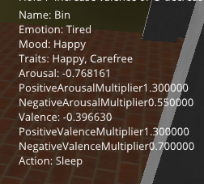
NPCs - Emotions
Speaker: Dylan Blereau
States | Emotions | Moods | Traits
Positive Arousal – Positive Valence | Happy, Delighted, Excited | Happy | Happy, Delighted, Cheerful
Positive Arousal – Negative Valence | Frustrated, Angry, Tense | Angry | Impatient, Aggressive, Paranoid
Negative Arousal – Positive Valence | Content, Relaxed, Calm | Relaxed | Patient, Peaceful, Carefree
Negative Arousal – Negative Valence | Depressed, Bored, Tired | Sad | Depressed, Bland, Sad
Notes:
Seeing as the Circumplex Model places emotions in one of the four quadrants of the model, we thought it best to represent each quadrant as a state. In order to make Moods and Traits easy to understand and implement we made some for each of the four states.
Each state has three emotions, one mood and three traits, meaning there are total of 12 emotions, 4 moods and 12-character traits to use to create NPCs.
The emotion of an NPC can be set by providing the NPCs EmotionComponent with a valence and arousal value, with manipulation of both values allowing for transition into different emotions.
Whenever arousal and valence is decreased or increased the value given is multiplied by a multiplier that is created using the NPCs mood and traits, meaning that moods and traits determine how quickly or slowly NPCs transition into different emotions.
As Moods are more situational than underlying personality traits, they are given a higher overall weighting, but traits also still play a role, with NPCs allowed up to three traits. Like emotions, traits have different levels of severity, with varied levels of weighting.
The multipliers can be seen here in the photo of the Bin’s emotion information. Despites his currently negative arousal emotion of Tired, his Happy Mood and Happy Trait sees his PositiveArousalMultiplier increase, meaning events that increase his arousal are going to have more of an impact. His negative valence multiplier is also less than its default value of 1, meaning that negative valence affecting events have less of an impact on him, due to his overall positive being.

Slide 10
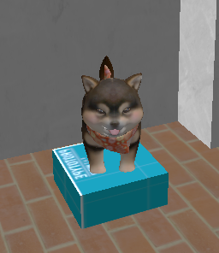
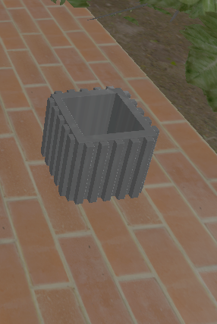
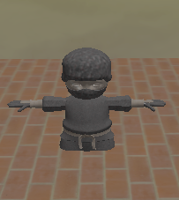
NPCs - Emotions
Speaker: Dylan Blereau
Taco the Dog
Emotion:
Bored
Mood:
Relaxed
Traits:
Aggressive
Sad
Barry the Bin
Emotion:
Happy
Mood:
Happy
Traits:
Happy
Carefree
Sam the Student
Emotion:
Relaxed
Mood:
Happy
Traits:
Delighted
Peaceful
Tired
Notes:
These here are the three different NPCs we have in our demo, each with their own combination of Emotion, Mood and Character Traits.
First up is everyone's favourite dog Taco, who despite being bored and in a relaxed mood, has some pretty negative valence traits.
Barry the Bin on the other hand is as happy as can be.
Lastly we have Sam, who despite being a University Student and also a T-Posing Ninja is pretty Relaxed and Happy across the board, albeit a little tired as well.
In summary, our emotion system allows for the creation of NPCs with differing moods, and personalities, which in turn formulate a value that affects how they transition between emotions. Emotions also affect what the NPC does in the virtual environment, including their action values for affordances.
I’ll now pass you on to Chris who will explain Affordances, as well as how we use them with our NPCs.

Slide 11
Affordances – Objects
Speaker: Christopher Logan
Affordances for Objects | Modelled | Example. Game Console
Have different Actions that can be applied/done to them | Actions Enumerators | Playing
These actions can have different levels | 0 – 1 decimal value for each action | 1

Slide 12
Affordances – Objects continued
Speaker: Christopher Logan
class Affordance
public:
…
float GetActionValue(Actions action);
void SetActionValue(Actions action, float value);
…
private:
unordered_map<Actions, float> objectsActions;

Slide 13
Affordances - NPCs
Speaker: Christopher Logan
Actions desiredAction -> SetDesiredAction(Abuse)
float affordanceLevel -> SetAffordance(0.1)
float actionDistance -> SetActionDistance(7.0)
Taco the Dog
Tense Emotion

Slide 14
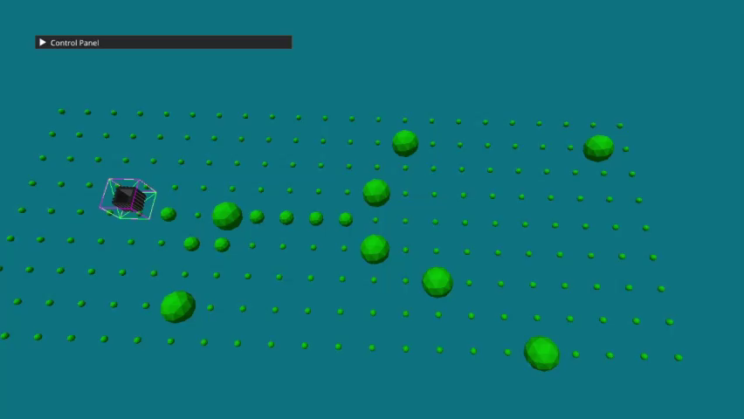
Special Features – A* Pathfinding
Speaker: Christopher Logan
NPCs to wander the map
Provides path finding
Dynamic Obstacles
Random Valid Destinations

Slide 15
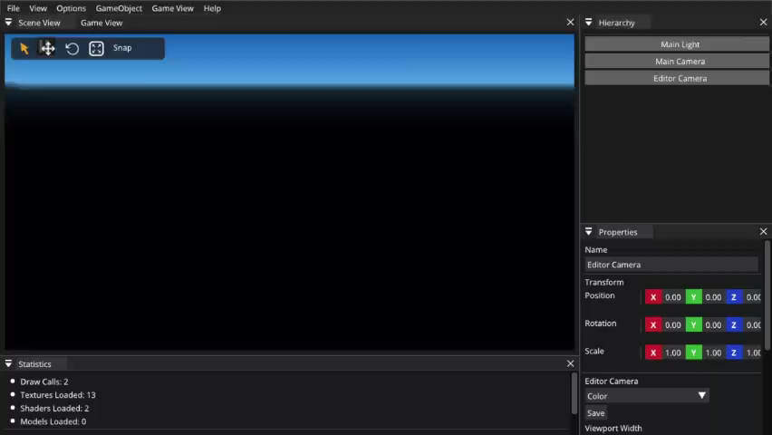
Special Features
Speaker: Bryce Standley
Custom Scene Editor
Custom Scene Serialization
Khronos Textures (KTX)
Entity Component System – ENTT
3D Audio - IrrKlang
NPC Dialogue/Action Queue
Notes:
Some additional features developed into the engine include:
A custom scene editor application leveraging the modularity of the engine allowing scenes to be loaded, edited and saved back to disk using a custom scene serialization structure that closely resembles HTML / XML.
Khronos Texture support (KTX) for cube texturing. The Khronos Texture format is an efficient lightweight GPU texture format developed by Khronos Group for OpenGL and Vulkan. Our engine uses a modular approach to texturing allowing both standard image and KTX image textures to work together. Currently KTX textures are only supported for skybox environments but further texturing support is planned for the future.
A major addition to the engine was a Entity Component System to better manage objects and their properties within an application. We implemented the ENTT lightweight library that handles the full lifespan of components added to a given object and allows easy access to all components on a given object via a entity identifier.
3D Audio within the engine is implemented using the IrrKlang library. Audio leverages the component system to be able to add both audio sources and audio listeners into a world / scene. The IrrKlang library also enabled the ability to disable 3D effects within listeners allowing for 2D background audio as well.
An additional feature developed along side the AI system was a NPC Dialogue and Action queue system using the ImGui user interface library to display dialogue and actions of a NPC on the screen to the user.

Slide 16
Demo Time

Slide 17
Question Time
Notes:
Thanks for listening to our presentation. Are there any questions?

